Slide 1

SEAM AI
Applied Geoscience Hackathon
Application Form
Due 1 March 2021

Slide 2
TEAM CONTACT INFORMATION
Instructions:
In the box below, please provide a team name and contact information for the team member who will handle communications regarding the event.
Team Name: MathWorks
Name of Team Lead for Communications: Samvith Rao
Email for All Event Communications: Samvith.Rao@MathWorks.com

Slide 3
understanding of Problem Statement
INSTRUCTIONS:
In the box below—and on following slides (if desired)—provide a narrative with your understanding of the problem statement and goals of the Applied Geoscience Hackathon. Use as many slides as you wish but try not to just copy from the information provided.
Quantitative facies classification is the key to understanding seismic data to evaluate important reservoir properties. During the past several years, the size of seismic volumes has piled up to the extent that it is challenging for geoscientists to manually examine every seismic volume to classify the facies. This is where new methodologies such as deep learning fit in. They help automate these tasks. However so far, this approach has not been a runaway success.
The reason is twofold –
During the initial rounds, the most important pixels to identify are faults and horizons. Most algorithms have trouble segmenting pixels at the boundaries of these prominent geologic structures.
Lack of appropriate metrics. While there are some quantitative measures drawn from the classic image processing domain (e.g. IOU), these are not ‘geologically informed’. An aim of this competetion is to test new metrics that indicate the true quality of fault or horizon extraction.

Slide 4
Proposed solution
INSTRUCTIONS:
In the box below, provide a description of your team’s proposed approach to the problem. This is just a starting proposal. If selected, your team will work with mentors and with input from other teams to further develop and implement your approach. Use as many slides as you wish.
Executive Summary: Our proposed method consists of upscaling the seismic images before feeding them to the deep learning model. We will use the wavelet transform as an upscaling technique. Wavelet based multiresolution analysis is a powerful framework for extracting relevant features from complex signals without adding any spatial distortions or artifacts. These features will be paired with AI models for classification.
To illustrate its feasibility and effectiveness, the proposed method was applied to seismic data from Antarctica, and we could clearly identify the interfaces between ice sheet and bed rock. The results have demonstrated that wavelets combined with deep learning can distinguish among different facies, helping the interpreter to process new seismic images. There are two main advantages of this method over using only deep learning:
Improved resolution at boundaries of geologic structures leads to better training data for the deep learning model and hence better classification achieving mean accuracy of 95%
Reduction in the amount of labeled data needed for training and increasing the productivity of the interpreter by ~10x

Slide 5
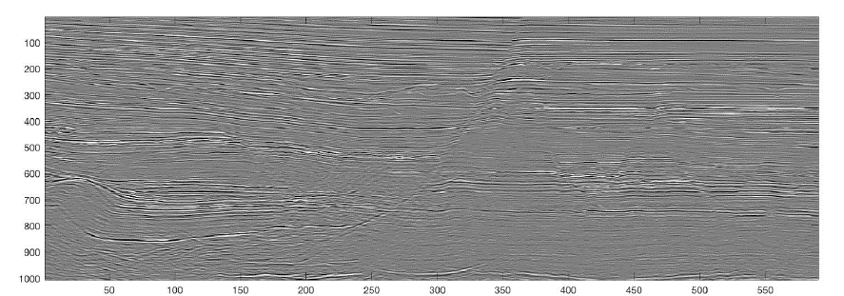
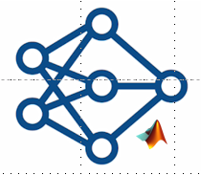
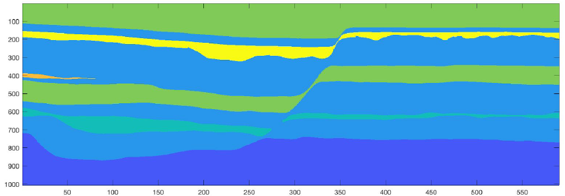

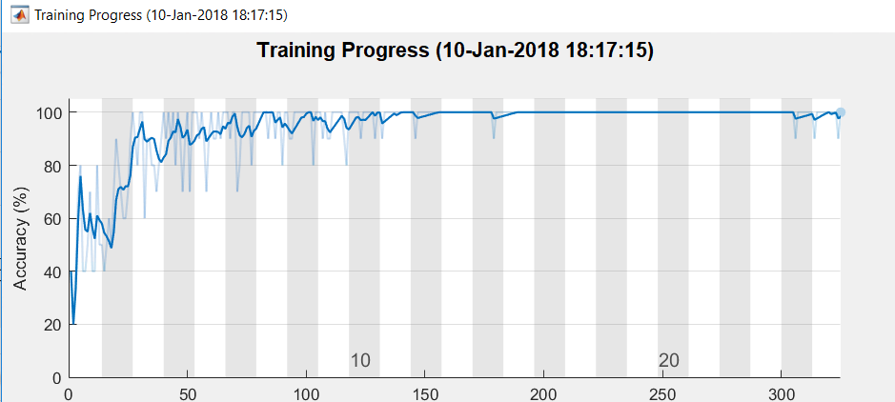
Proposed Workflow – Segmentation of images with wavelets & CNNs
Seismic Data
Signal Preprocessing with Wavelets
Train Deep Networks
Deploy network on NVIDIA GPU
Segmented Seismic Data
Test Network

Slide 6
CASE STUDY

Slide 7
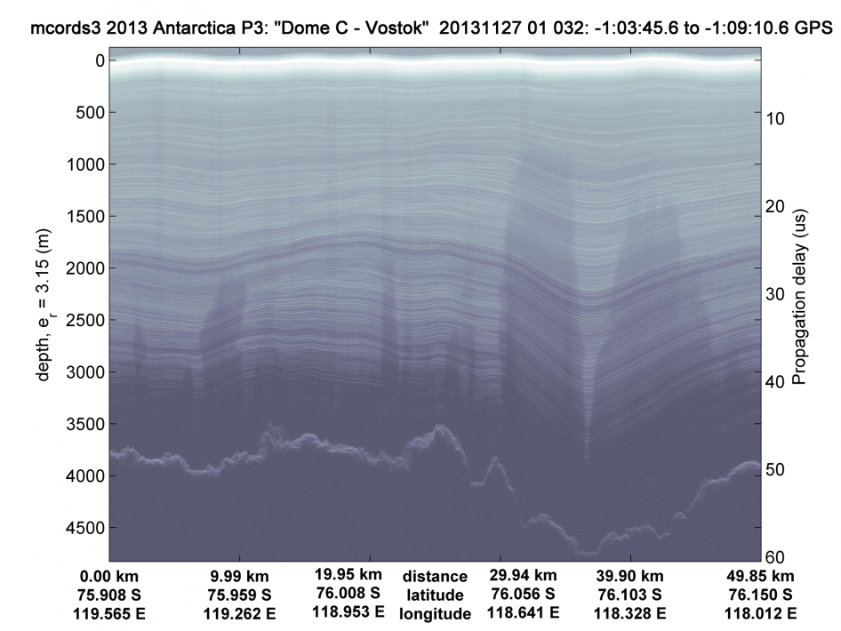
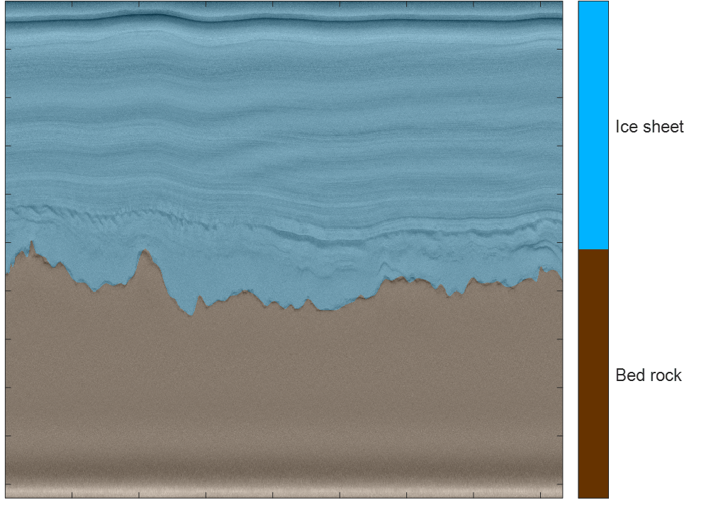
the proposed workflow has already been demonstrated successfully on polar ice sheets
Icesheets
Bedrock

Slide 8
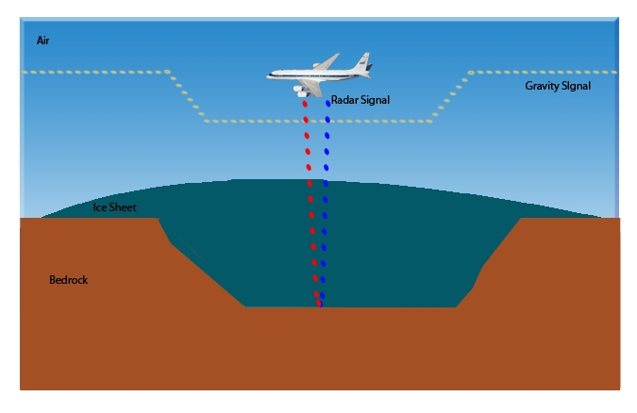
Radar data of Antarctic ice sheets are analogous to seismic data

Slide 9
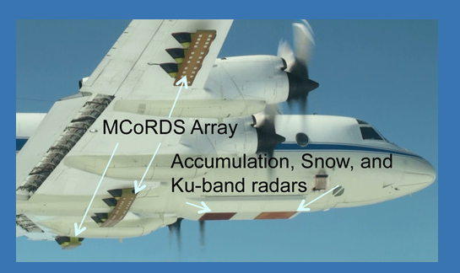
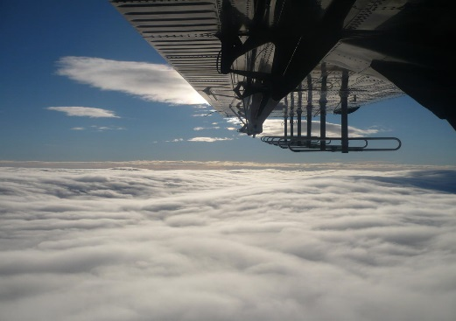
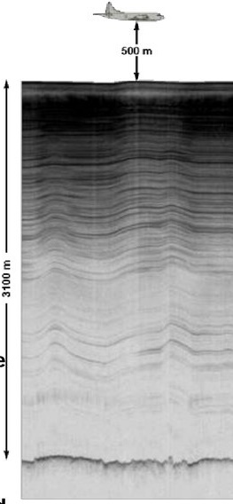
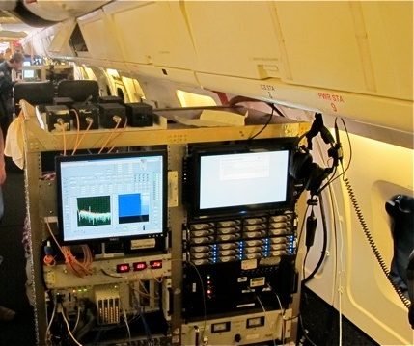
Case Study Data
MCoRDS/I – Multichannel Coherent Radar Depth Sounder/Imager
System parameters
Season 2012 2009
Operating frequency 180-210 MHz 140-160 MHz
Pulse Duration 1,3,10 μs 1,3,10 μs
Sampling freq 111.11MHz 120 MHz
Max Tx channels 8 6
Max Rx channels 16 6
Peak Tx Power ~1200W ~800W
A/D resolution 12 bits 12 bits
Min detectable signal -161 dBm -161 dBm
Noise Figure 5 dB 5 dB
Platform NASA P3 Twin Otter
*CReSIS. 2018. MCoRDS Data, Lawrence, Kansas, USA. Digital Media. http://data.cresis.ku.edu/
*Gogineni, S., J.-B. Yan, et al., "Bed topography of fast-flowing glaciers and fine-resolution mapping of internal layers", 26th IUGG General Assembly 2015, Prague, 06/22-07/2, 2015.

Slide 10
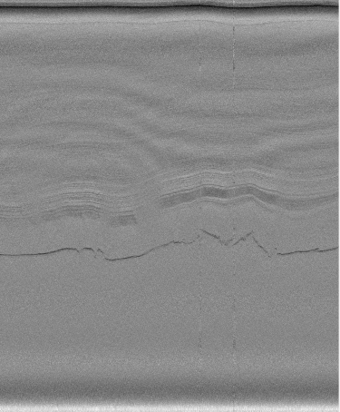
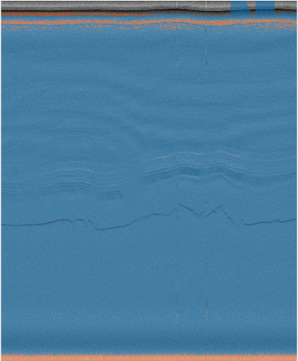
Developing Artificial Intelligence algorithm for automated labeling
Training :
Label Seismic Data
Train Deep Networks using CNNs
Train Network
Traditional approach – Did not work ☹
Deployed model :
Trained Model
New Data
Semantic Segmented Data
Global accuracy of trained model <10%

Slide 11
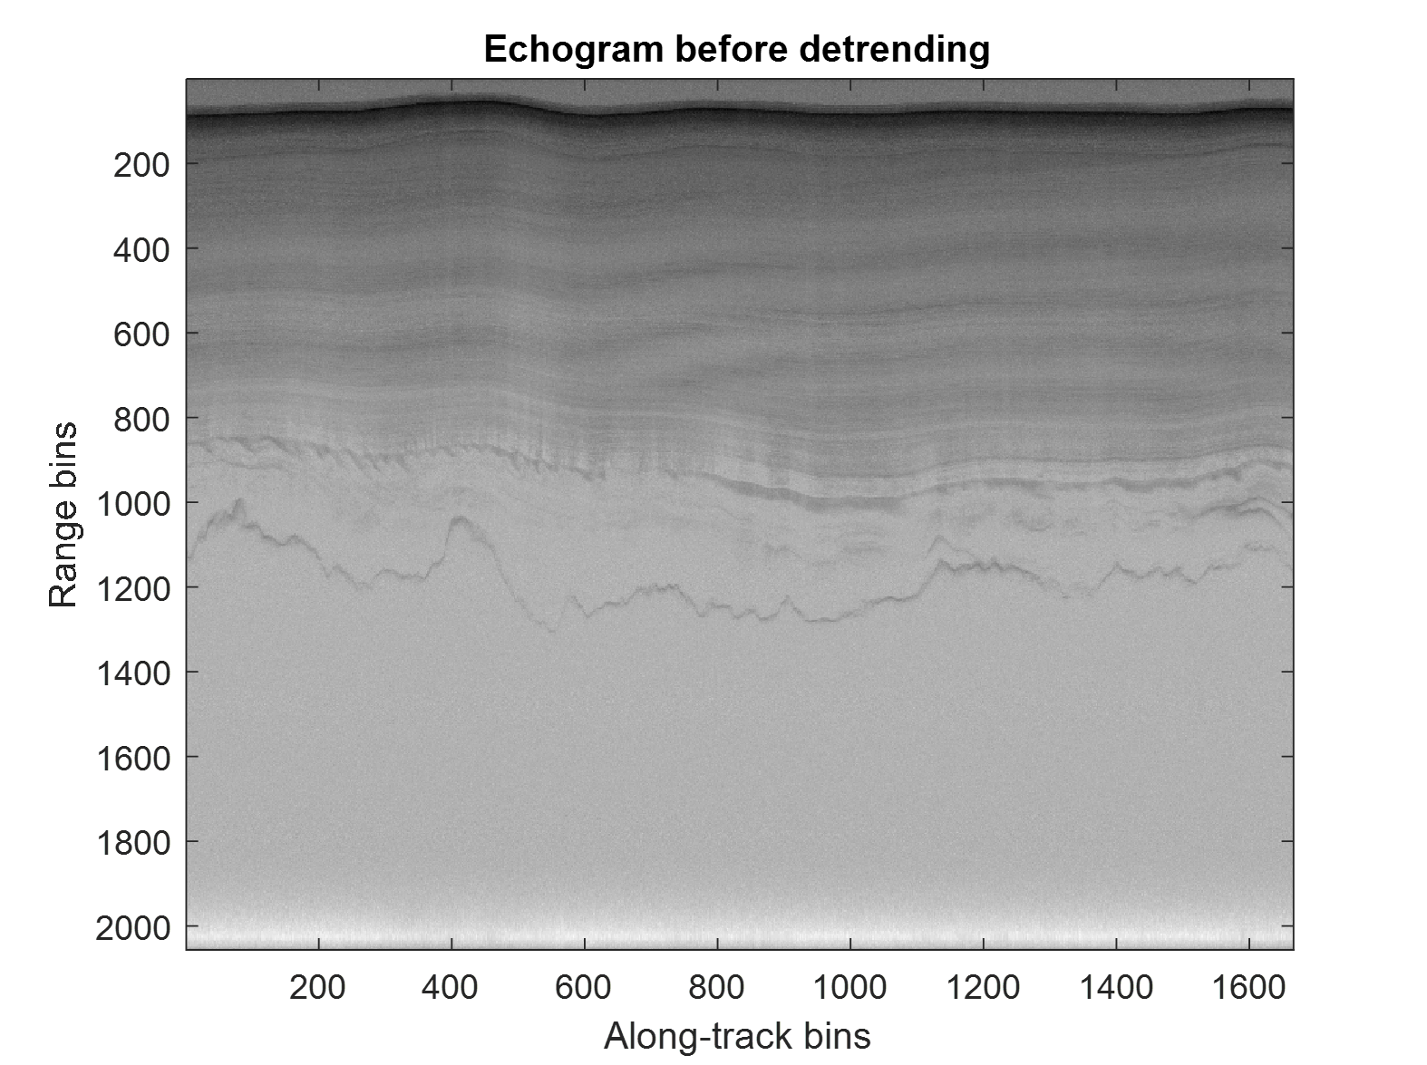
Why did our model fail?
Let’s understand the training data
Icesheets layers returns
>200 dB dynamic range
Bedrock return
High dynamic range results in :
Poor contrast in seismic image
Bedrock signal power very low
AI model cannot distinguish icesheet layers and bedrock

Slide 12
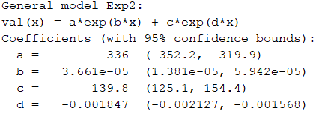
How to detrend this data ?
Some techniques available in literature :
Curve fitting
- Fit low order polynomial
- Fit an exponential function
Predictive deconvolution
- Inverse filtering
Example :
Exponential curve fit
Result :
Loss in SNR of the bedrock return
Original signal bed SNR = ~27 dB
Detrended signal bed SNR = ~20 dB

Slide 13
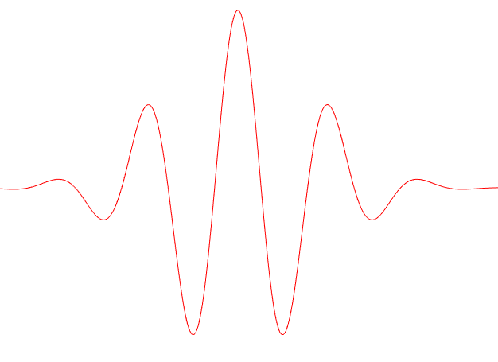
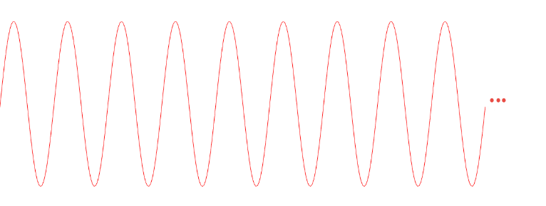
Which technique to use ?
Ans: Use wavelets analysis
Wavelet
A wavelet is a rapidly decaying wave like oscillation with zero mean
Wavelets are best suited to localize frequency content in real world signals
Availability of a wide variety of wavelets is a key strength of wavelet analysis
Sine wave

Slide 14
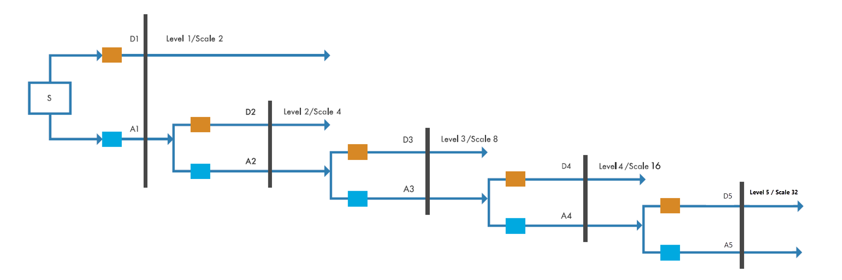
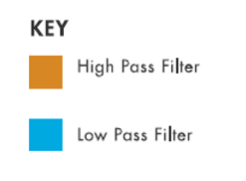
Introduction to Wavelet Multiresolution Analysis
Using DWT (Discrete Wavelet Transform) to analyze signals into progressively finer octave bands
90-180Hz
Fs: 360 Hz
45-90 Hz
22-45Hz
0-90 Hz
11-22 Hz
0-45 Hz
5 – 11 Hz
0-22 Hz
0-11 Hz
0-5 Hz

Slide 15
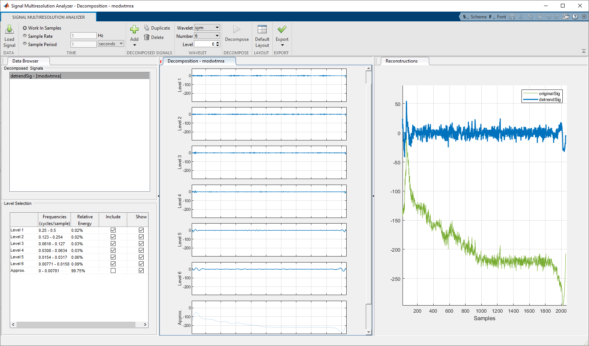
Signal Preprocessing using Wavelet Multiresolution Analysis
Decompose signal into multiple resolutions using wavelets
Higher levels capture high frequency trends
Reconstruct the signal by combining higher levels and removing the lowest approx. level
Lower levels capture signal attenuation profile

Slide 16
Signal Preprocessing using Wavelet Multiresolution Analysis
Results of multiresolution analysis
SNR of bedrock return is preserved as original signal ~27 dB
Used sym6 wavelet to preform the decomposition
Same wavelet decomposition method can be applied to all traces
Contrast of the seismic image improved

Slide 17
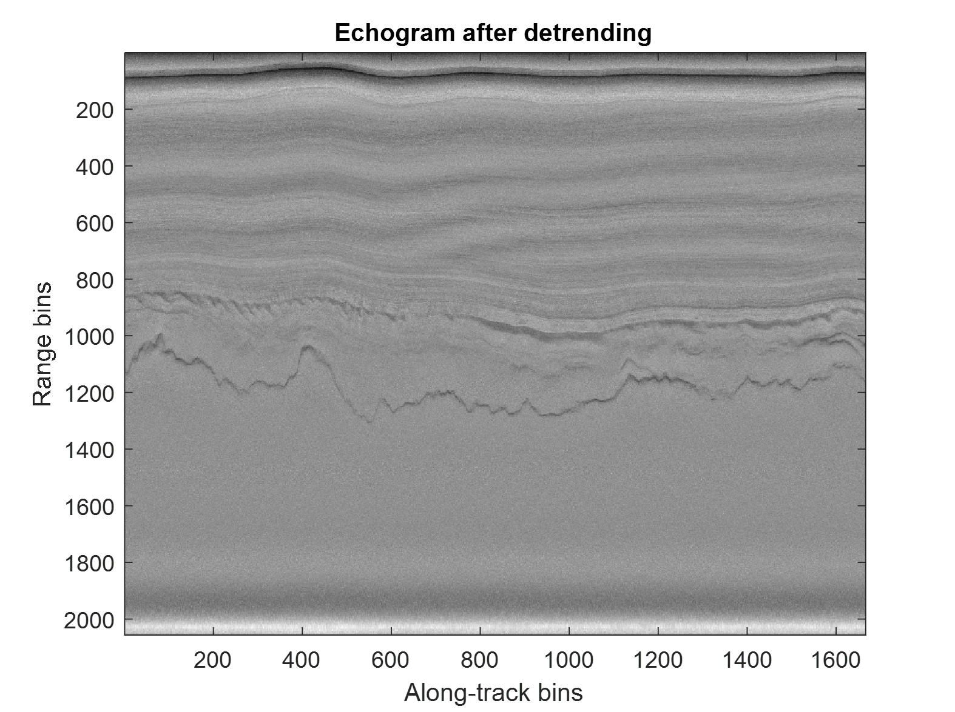
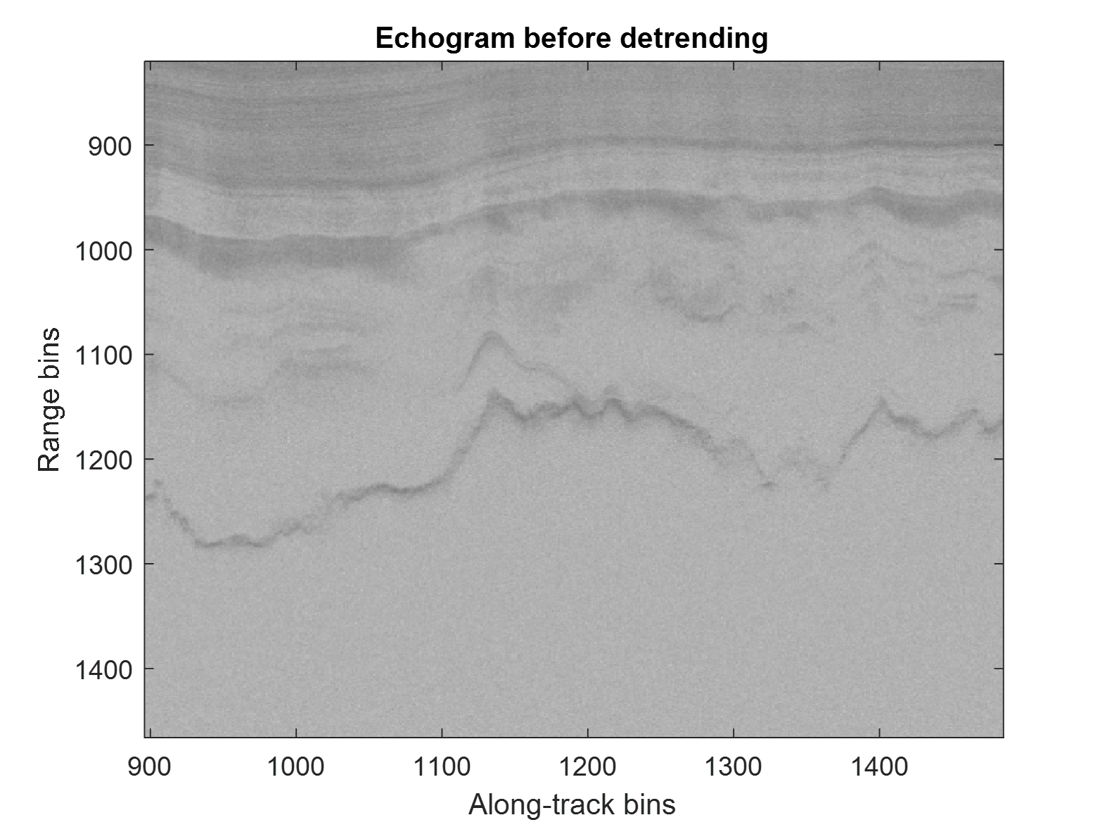
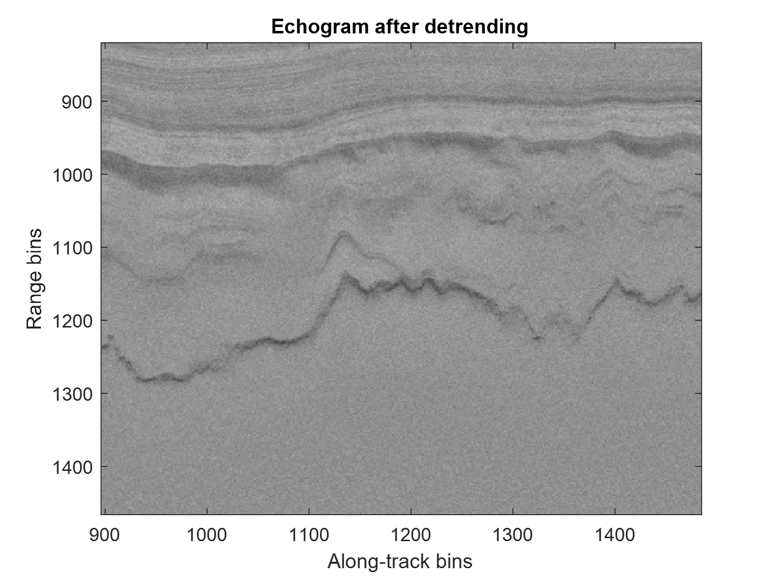
Wavelets improve contrast for geologic boundaries
Results of multiresolution analysis

Slide 18
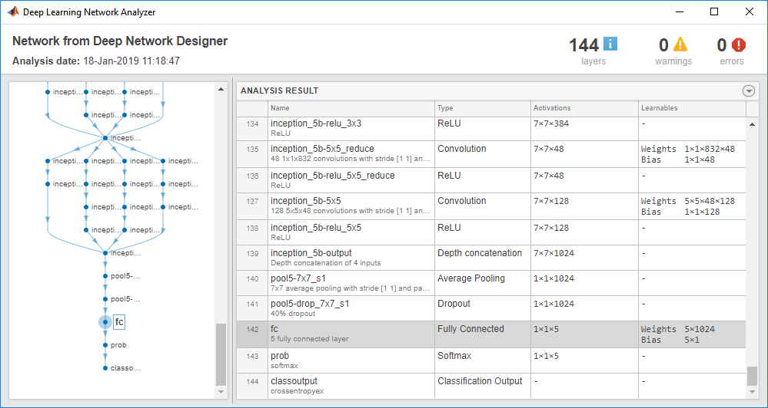

After preprocessing, build deep learning model and deploy to nvidia GPUs
Prepare Data
Train Model
Deploy
Data Labeling
Deployment
Wavelet
Preprocessing
Model Visualization and Design
Tools:
Wavelet Toolbox
Deep Learning Toolbox
GPU Coder
Notes:
Speaker Notes:
I will highlight some of the key features in MATLAB for the steps in the deep learning workflow that make it easier

Slide 19
Developing Artificial Intelligence algorithm for automated labeling
Traditional approach did not work
Training :
Label Seismic Data
Train Deep Networks using CNNs
Train Network
Deployed model :
Trained Model
New Data
Semantic Segmented Data
Global accuracy of trained model < 10%

Slide 20
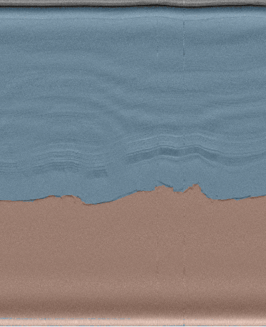
Developing Artificial Intelligence algorithm for automated labeling
New Wavelets based approach: AI model works ☺
Training :
Signal Preprocessing with wavelets
Label Seismic Data
Train Deep Networks using CNNs
Train Network
Deployed model :
Signal Preprocessing with wavelets
Trained Model
New Data
Semantic Segmented Data
Global accuracy of trained model ~ 95%

Slide 21
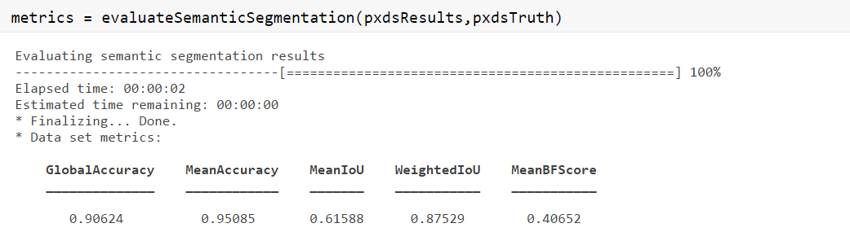
Overall result
Confusion matrix plot for all pixels
Semantic Segmented Data

Slide 22
Summary of case study
Direct application of deep learning model is not useful for facies segmentation
Signal preprocessing is an important step to leverage the latest AI techniques for seismic interpretation, particularly at geologic boundaries
Overall SNR Improvement in signals : Multiresolution analysis decreases the dynamic range, helps uncover features in low SNR scenarios
Accuracy of 95% achieved
Improved features of icesheet layers and bed rock

Slide 23
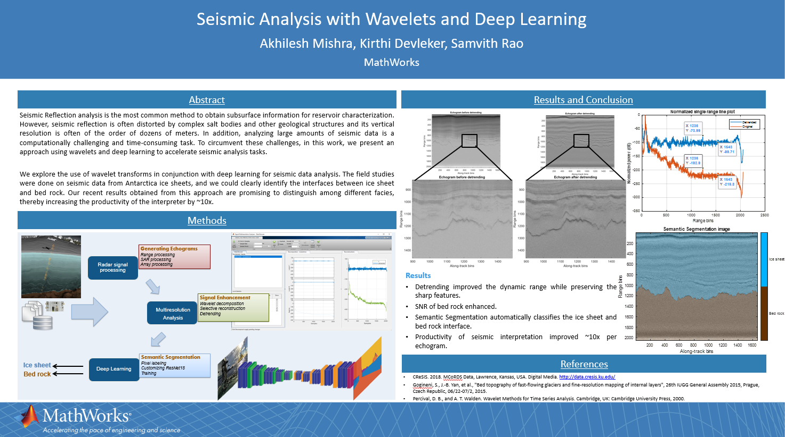
Paper presented at multiple conferences
AAPG ICE 2019, Buenos Aires
Geo Expo 2020 (link)
AAPG ACE 2020 (link - theme 7)
More details and full presentation in following videos
Seismic Analysis with Wavelets and Deep Learning
Wavelets – A hidden gem for Artificial Intelligence in seismic interpretation
Poster presented at AAPG ICE 2019

Slide 24
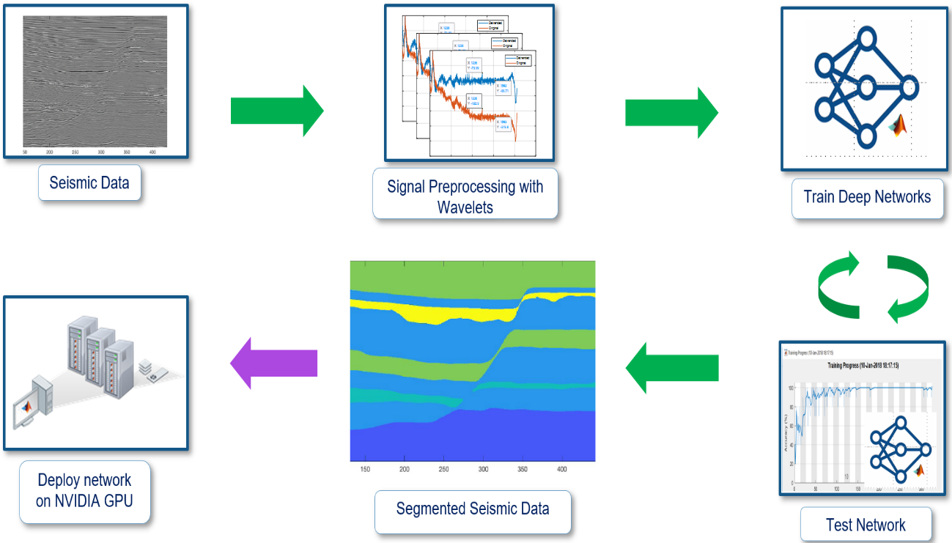
We propose using the same workflow for parihaka seismic volume
We propose to apply the wavelet transform to all seismic data as a preprocessing technique
By improving the quality of the data for the deep learning algorithm, this methodology allows for the determination of layer boundaries, faults, and fractures. Thus, we can directly tackle one of the challenges of this hackathon
Finally, we intend to use GPU Coder to automatically generate CUDA code for deployment to NVIDIA GPUs

